Slide 1
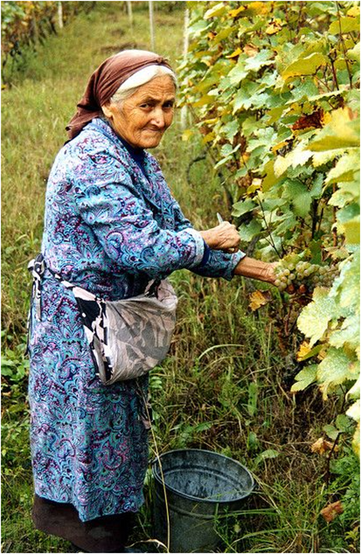
Red Wine Demand
By Julia Sherriff, Data Scientist,
ABC1 Consultants (an academic construct)
Sponsored by
Community Shares Bank (an academic construct)
Springboard Data Analysis Capstone
File created on: 2/13/2022
by IREX

Slide 2

Red Wine Demand
Wine market has reached USD 339.53 billion worldwide in 2020. From 2021 to 2028, it is projected to grow by 4.30%
(from Fortune Business Insights)
1. Could review participation help predict the demand?
2. How well are the ratings reflected in prices?
3. What are the geo-patterns and trends in ratings and prices of red wine?
Notes:
According to Fortune Business Insights, The wine market has reached globally 339.53 billion USD in 2020. From 2021 to 2028, it is projected to grow by 4.30%.
The sustainability of the wine industry largely depends on the market demand and the development of strategies to best fit the interests of wine consumers. We see the major overall opportunity in gauging the elements of the demand for risk control in wine making and distribution.
The purpose of this presentation is to advise US wine distributors of the ways to predict and possibly influence the demand for red wine. In this presentation, we will deliver the evaluation of how well the potential demand, as measured in wine reviews, is utilized in bringing value to the consumer.

Slide 3
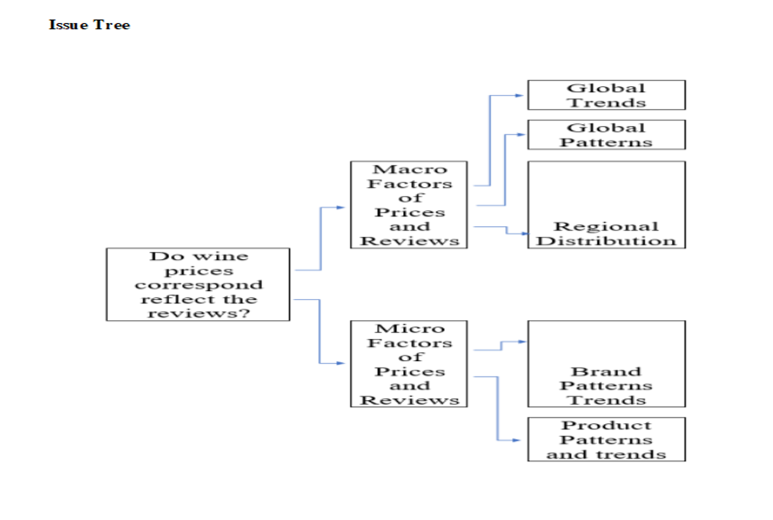
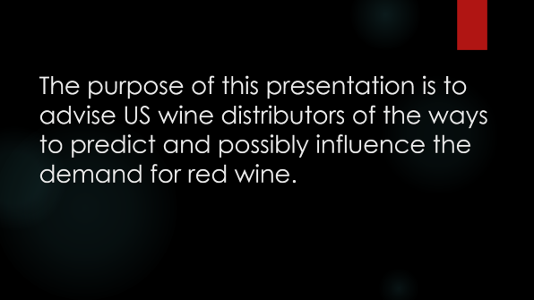
Specific Aims
1. To compare the patterns and trends in the price and reviews on macro level
End points: significant moderate correlation between price and review scores and volumes on global and regional level
2. To compare the patterns and trends in the price and reviews on micro level
End points: significant moderate correlation between price and review scores and volumes on global and regional level
Notes:
This study was focused on the assessment of patterns and trends in the prices and reviews on macro and micro level with the end points of correlations in review scores and volumes and the wine prices.

Slide 4
The purpose of this presentation is to advise US wine distributors of the ways to predict and possibly influence the demand for red wine.
Notes:
All

Slide 5
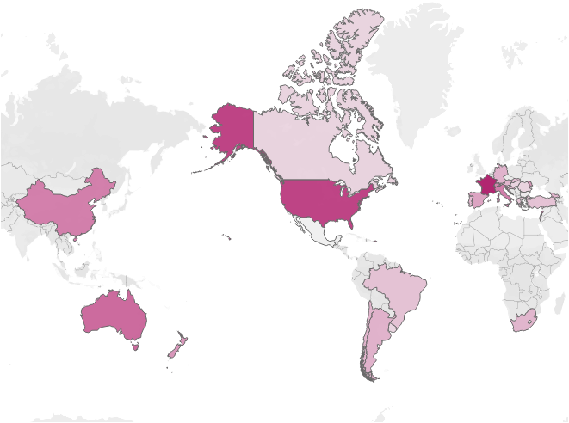
Global Wine Prices
Red wine prices are higher in France and the U.S.A.
Notes:
All

Slide 6
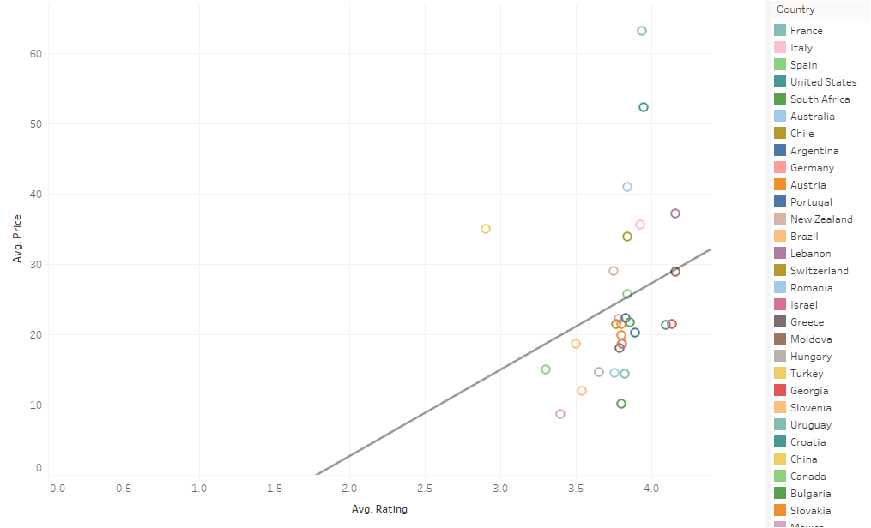
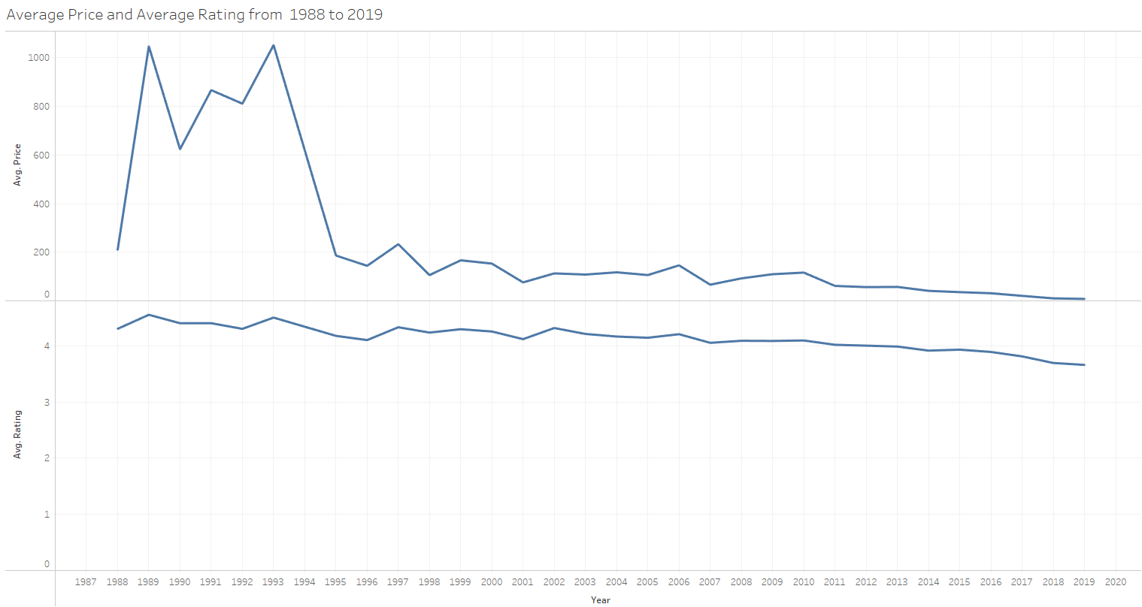
Wine Rating Compared to Prices by Country
Pattern similarity in price and rating trends, 1988-2019
*Early data collection bias for more expensive red wine
Notes:
HIDE FOR NONTECH

Slide 7
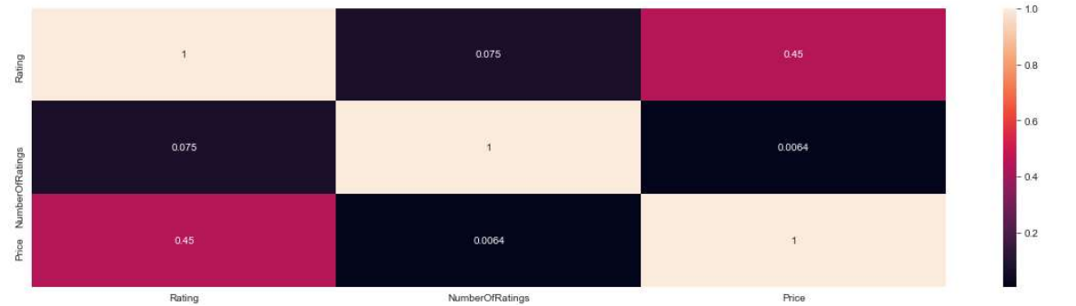
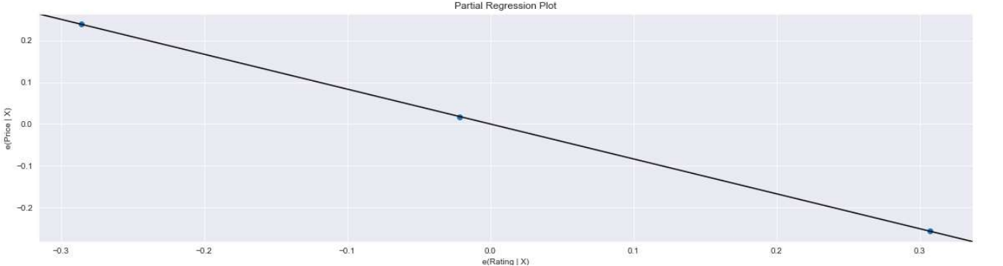
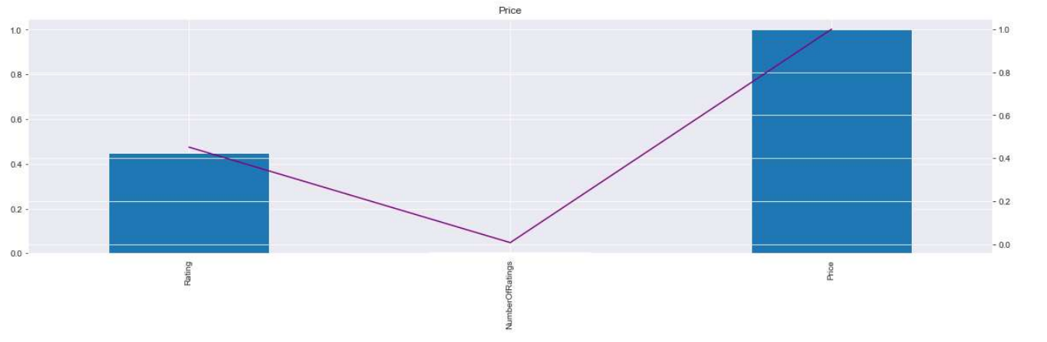
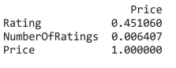
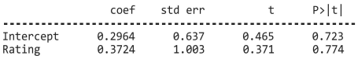
What is the correlation ?
Notes:
HIDE FOR NON-TECH

Slide 8
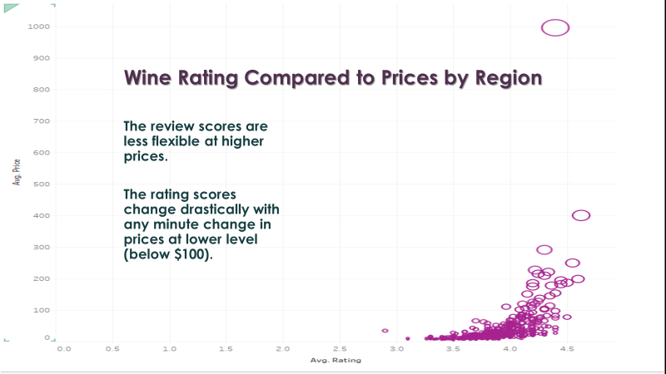
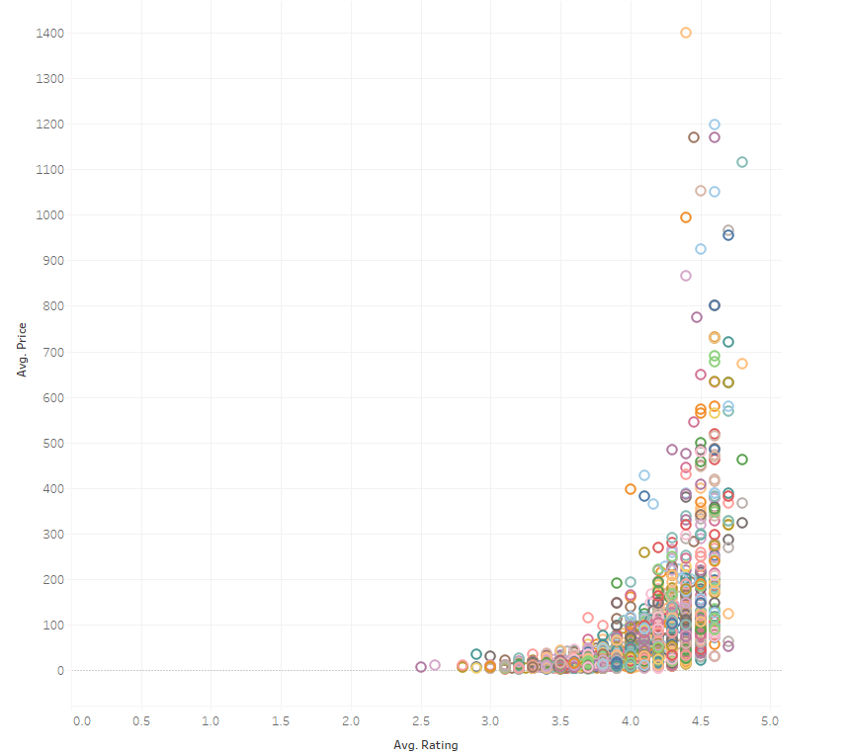
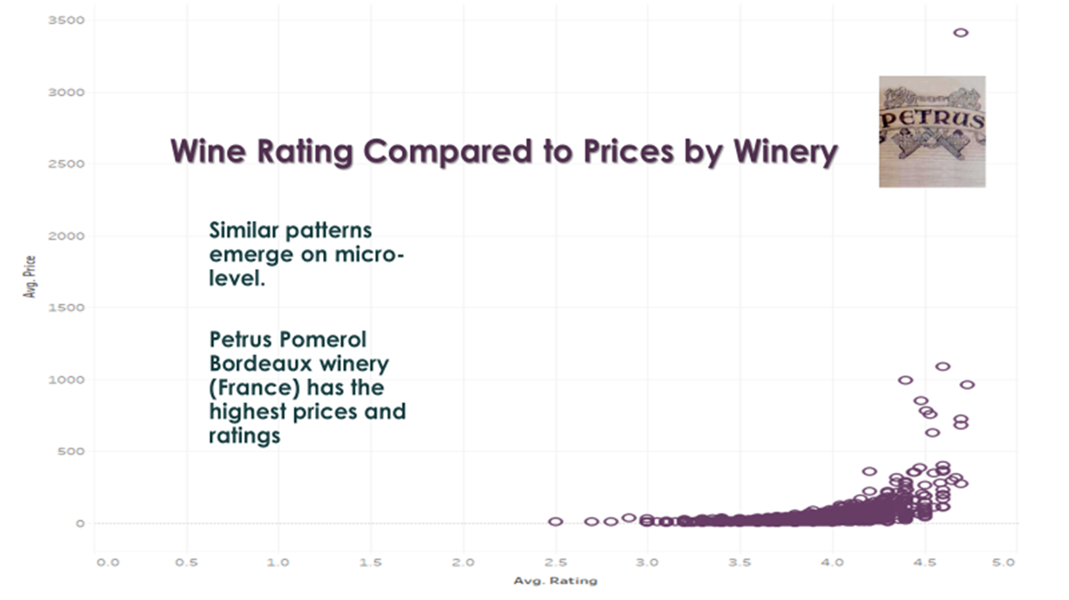
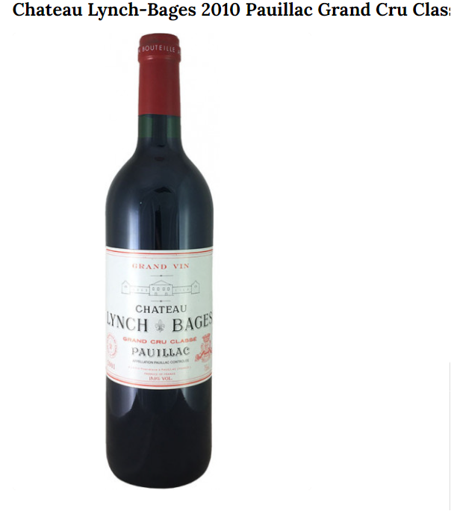
Wine Rating Compared to Prices by Name
The wine with the highest price and rating is
Château Lynch-Bages[lunch-bajj]
Pauillac (Grand Cru Classé)
Here at ~$1200 (current price online is $349.99)

Slide 9
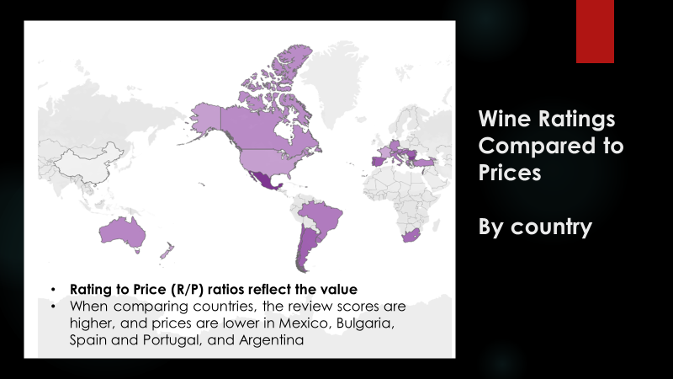
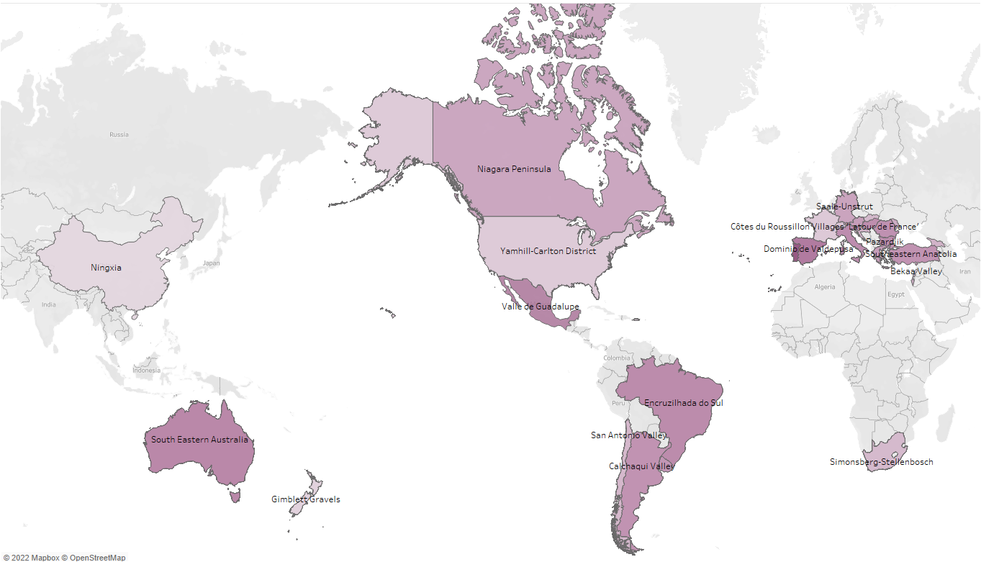
Wine ratings compared to prices by wine regions
The pattern of global distribution of ratings compared to prices is somewhat different when comparing wine regions.
Notes:
Ratings compared to price are great in Mexico, Spain, and South of South America

Slide 10
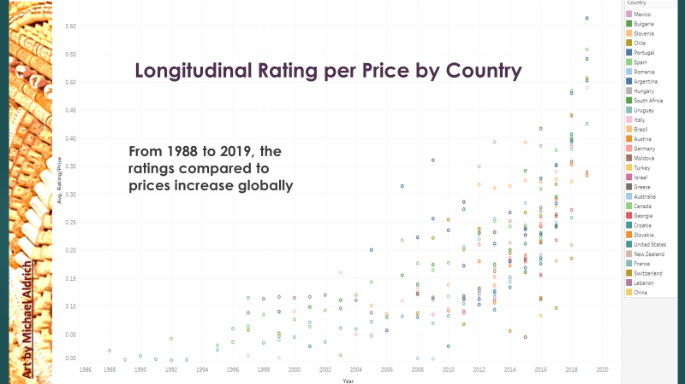
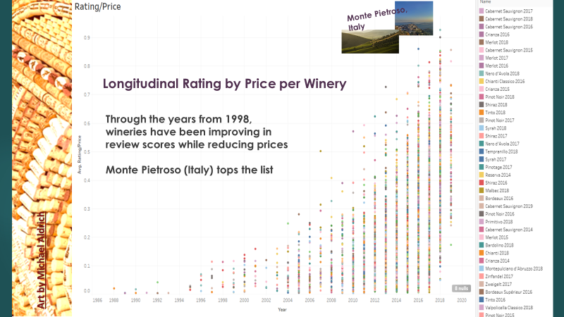
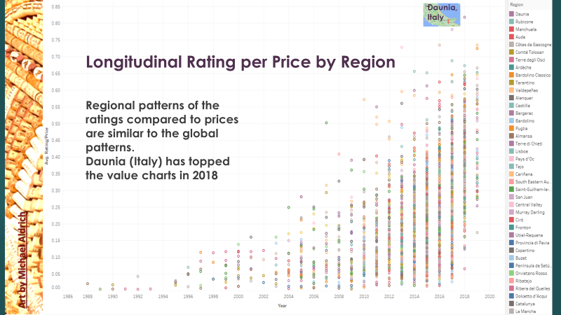
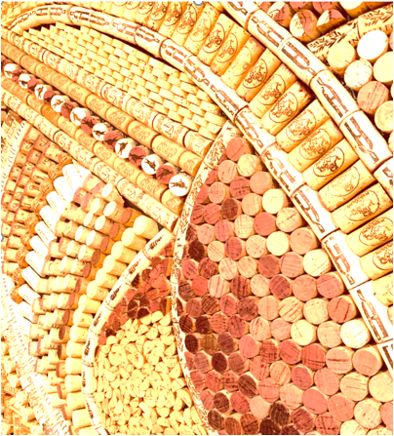
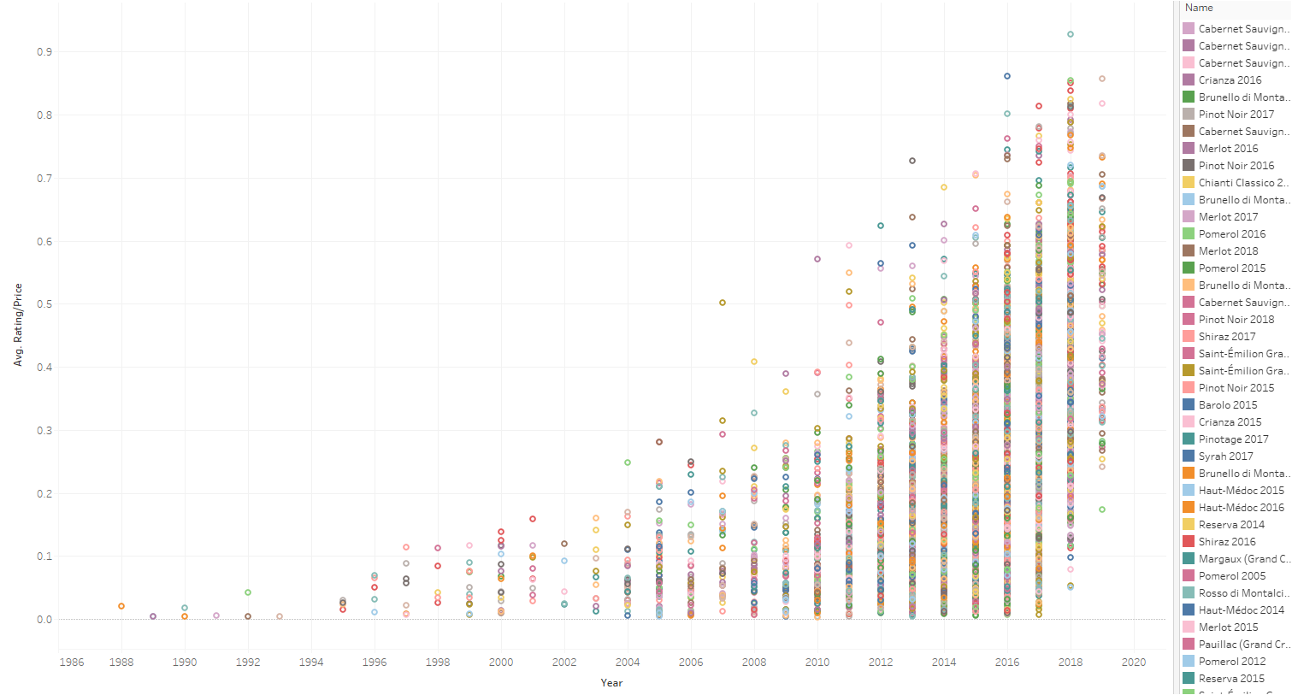
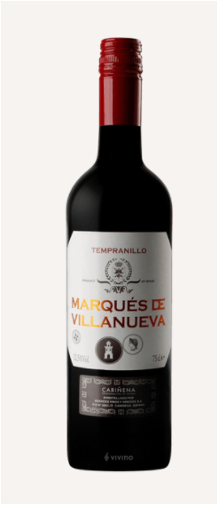
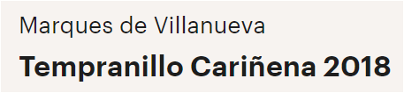
Rating per Price Longitudinal by Name
Rating-to-Price ratio patterns for Specific wineries have similar patterns on regional, brand, and wine names.
Marques de Villanueva (Spain)
Tempranillo Cariñena 2018 at around $6.18 average and 3.4 in reviews
tops the value list of wine names.
Art by Michael Aldrich

Slide 11
SUMMARY
Significant moderate correlation exists between pricing and review ratings
No significant differences have been observed in transition from macro to micro patterns (globally, regionally, by wineries, by product names)
Rating/price trends are positive with a transitional elasticity linked to price level
Limitations
Sales volume could not be assessed
The cost of surveys could have factored into the prices
Data source has not been formally evaluated
Time period is limited to that in dataset: 1988-2019
Future Research
Greater description of data collection methods and techniques would have aided this evaluation
New metrics should be considered
Price-level elasticity
Julia.Sherriff@Gmail.com

Slide 12
To predict the demand: 1. Ratings likely predict the demand 2. Ratings are reflected in prices, but the correlation is only moderate 3. No significant differences have been observed when transitioning from macro to micro patterns
Data Source:
Yasser MH. Anton Budnyak. Wine Rating & Price. Kaggle. Last retrieved 3/2/2022 from https://www.kaggle.com/budnyak/wine-rating-and-price Usability 9.7; Red.CSV (Columns: 8667), 1998-2019
Other Refences:
The global wine market is projected to grow from $340.23 billion in 2021 to $456.76 billion in 2028 at a CAGR of 4.30% in forecast period, 2021-2028. Fortune Business Insights. Last retrieved 3/2/2022 from ttps://www.fortunebusinessinsights.com/wine-market-102836
Licenses https://creativecommons.org/licenses/by-nc-nd/4.0/
Artwork:
Aldrich M NapaArtCellar Retrieved 2/15/2022 from https://www.etsy.com/shop/NapaArtCellar?ref=simple-shop-header-name&listing_id=778991561
Sowers G Wine Cellars Retrieved 2/15/2022 from https://www.pinterest.com/whiskeysowers/wine-cellars/
IREX, Wood S. Grapes for my Grapie https://www.pinterest.com/GrapeUnknown/grapes-for-my-grapie/
i-Cons: Vivienne Westwood. Retrieved 2/27/2022 from https://www.youtube.com/watch?v=ECZJE16uyPw
Art by Michael Aldrich

Slide 13
Data Sources:
Yasser MH. Anton Budnyak. Wine Rating & Price. Kaggle.
Usability 9.7; Red.CSV (Columns: 8667), 1998-2019 Last retrieved from
https://www.kaggle.com/budnyak/wine-rating-and-price
Other Refences:
The global wine market is projected to grow from $340.23 billion in 2021 to $456.76 billion in 2028 at a CAGR of 4.30% in forecast period, 2021-2028
Read More at: https://www.fortunebusinessinsights.com/wine-market-102836
Licenses https://creativecommons.org/licenses/by-nc-nd/4.0/
Artwork:
Aldrich M NapaArtCellar Retrieved 2/15/2022 from https://www.etsy.com/shop/NapaArtCellar?ref=simple-shop-header-name&listing_id=778991561
Sowers G Wine Cellars Retrieved 2/15/2022 from https://www.pinterest.com/whiskeysowers/wine-cellars/
IREX, Wood S. Grapes for my Grapie https://www.pinterest.com/GrapeUnknown/grapes-for-my-grapie/
i-Cons: Vivienne Westwood. Retrieved 2/27/2022 from https://www.youtube.com/watch?v=ECZJE16uyPw

